Slide 1
Go Pokémon Go!
Exploring the world of one of the most globally beloved games
Notes:
Slides shared by Kasim
Sara intros

Slide 2

Meet the Team
Sara McLean:
HTML Coding, Website Development, PowerPoint
Vanessa Lee:
DB, Flask API, Heatmap Chart
Serafin Juarez:
DB, Flask API, Bar Chart, Pokemon SME
Kasim Ahmad:
DB, PG Admin, Jupyter NB Table Development, Flask API
Daniel Rossi:
Radar Chart, JS Library integration
Notes:
Sara

Slide 3
Project Scope and Purpose
Pokémon is a game that has become a global phenomenon over its year lifespan and is celebrating the 25th anniversary in 2021.
Join us in exploring the world of Pokémon! This internationally beloved game is a staple of gamers everywhere and our project explores the game, highlighting the history, characters and territories of this complex game using a dashboard page with a drop-down menu for character background, types and special powers, as well as territories. A great tool for beginners and advanced users of Pokémon!
Notes:
Serafin

Slide 4
Data Sets and Process
Sourced from Kaggle
Pokedex_0420.csv
Pokedex_0520.csv
Python Pandas Library
Postgres SQL
Flask API
Notes:
Kasim

Slide 5
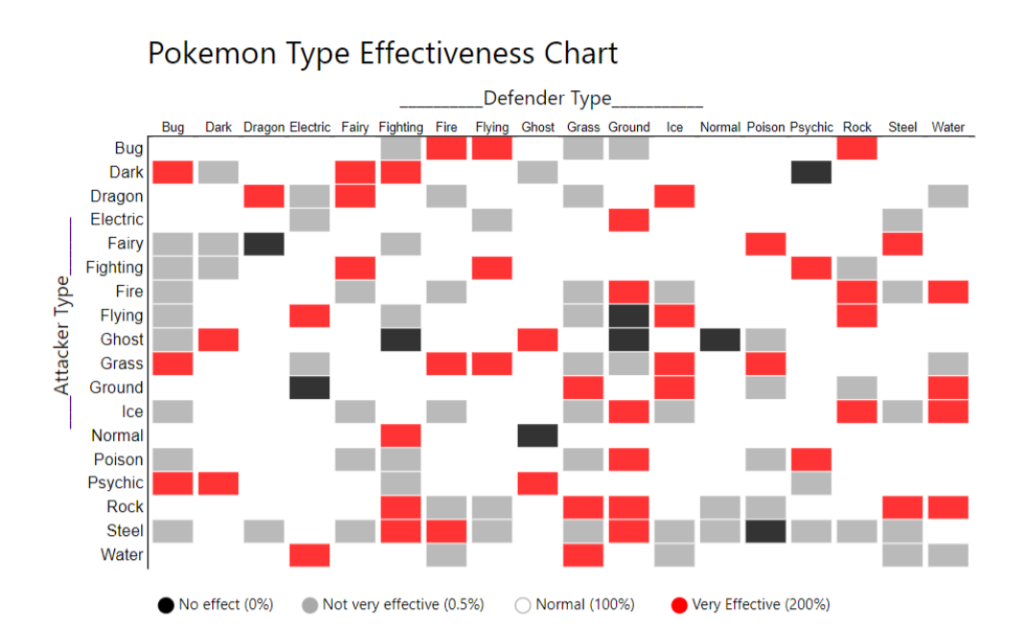
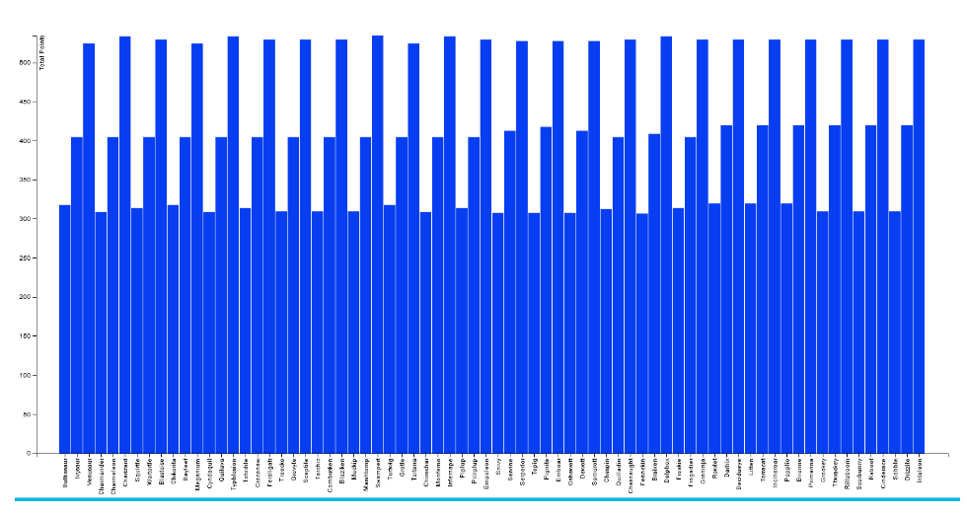
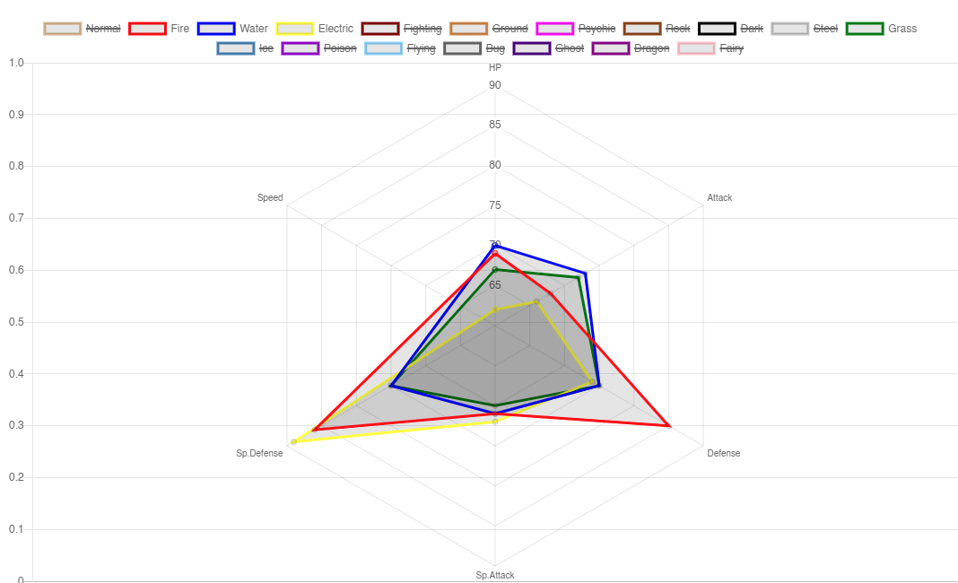
JavaScript Visualizations
Heatmap
Pokémon typing & effectiveness – Displays:
Normal Effective match-ups
Super Effective match-ups
Not-very effective match-ups
No effect match-ups
Bar Chart
Total base stats comparison between starters of all generations
Radar Chart
Average of stats per type breakdown
Notes:
Kasim

Slide 6

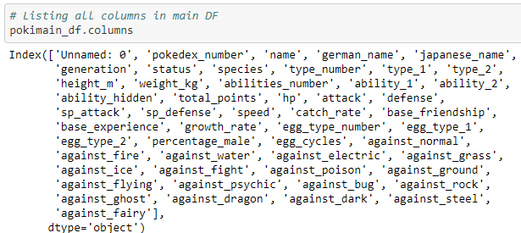
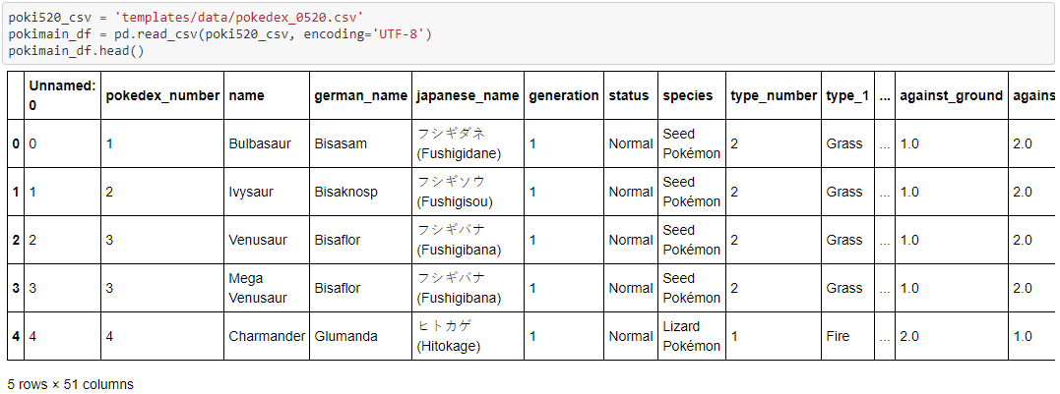
Source Dataset
Summarized Key Columns in Original Dataset:
Pokedex number
Name
Generation
Type
[STAT INFORMATION]
[EFFECTIVENESS]
Notes:
Kasim

Slide 7
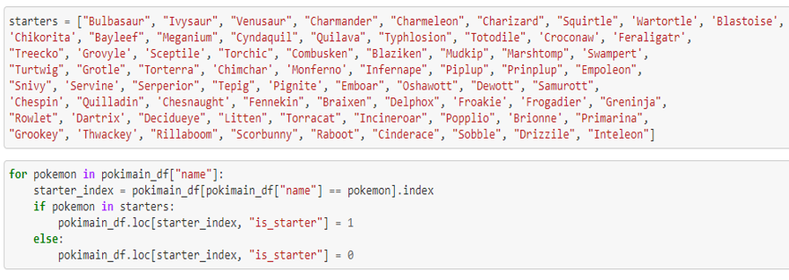
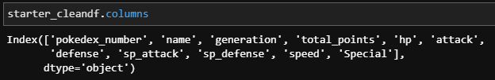
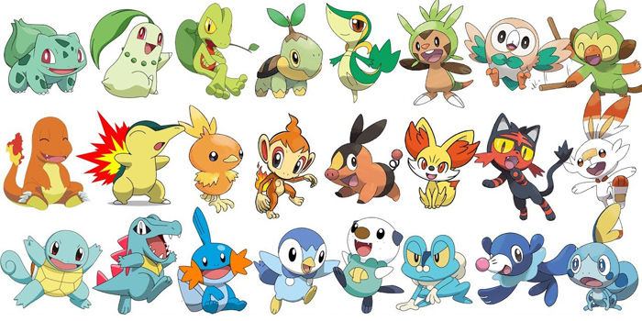
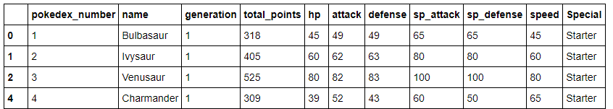
Pandas Data Cleaning – Starter Data
Specified starters by values in “name” column:
Looped through list with a
Boolean value in a custom column:
Final column to exported to PostgreSQL:
Notes:
Kasim

Slide 8
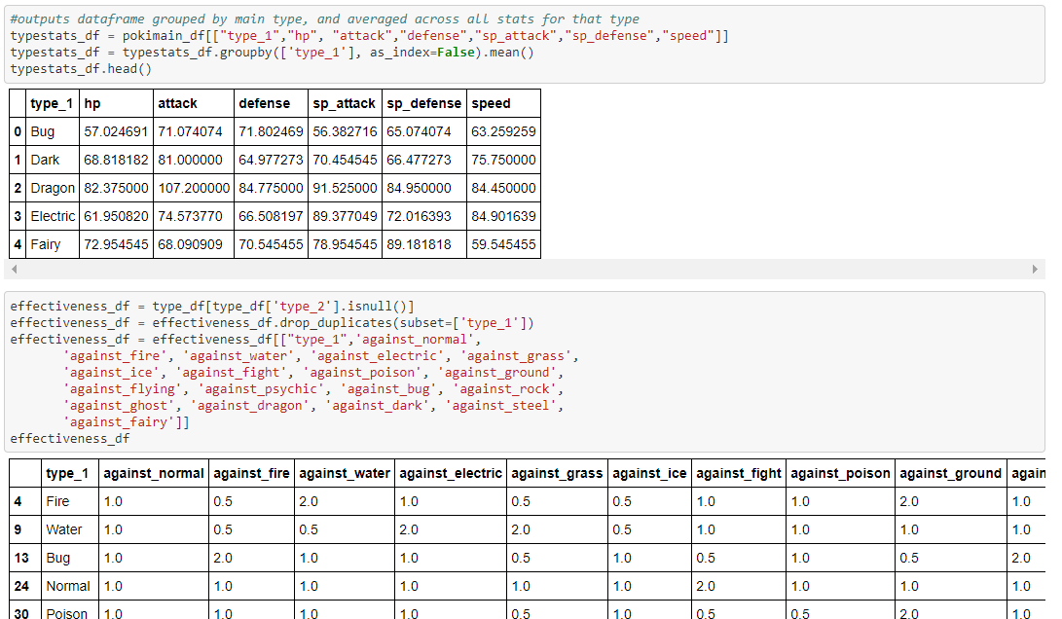
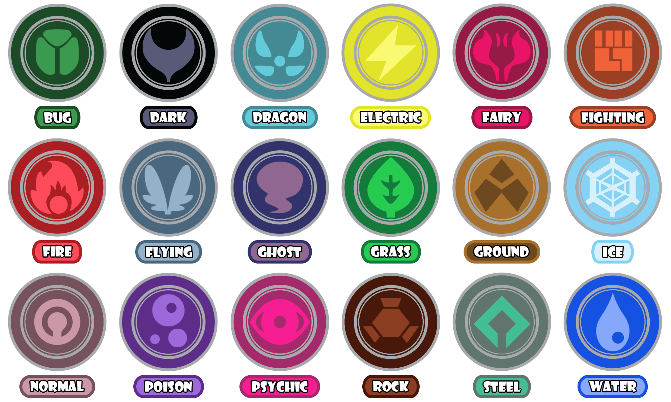
Pandas Data Cleaning – Type & Effectiveness
Typing grouped and stat
averages:
Singular typing and effectiveness:
Notes:
Kasim

Slide 9

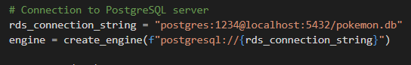
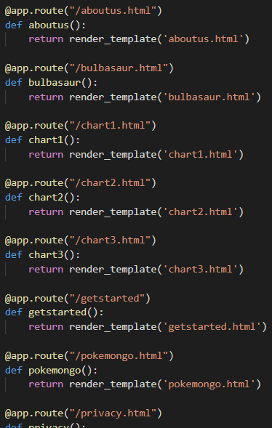
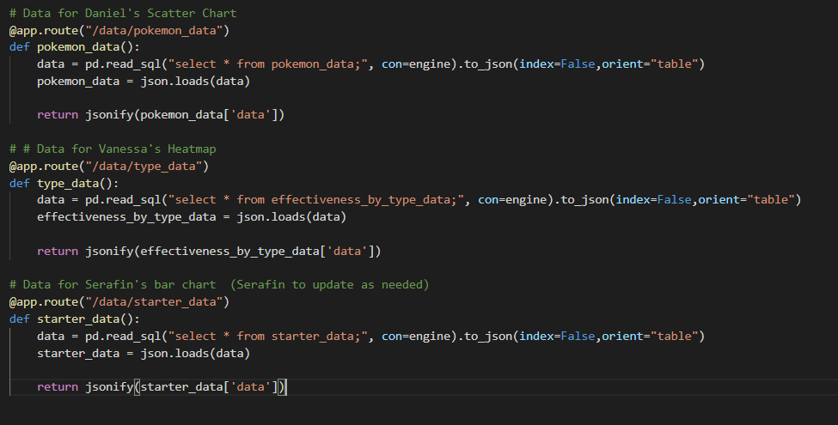
PostgreSQL connection + Flask
Notes:
Kasim

Slide 10
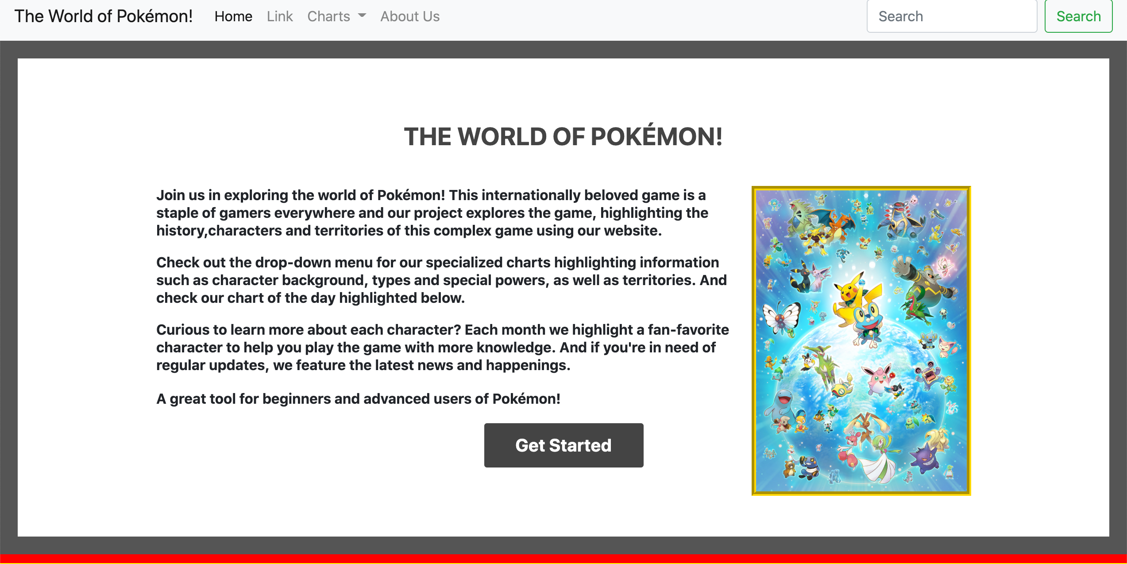
HTML Website Development
HTML – 11 landing pages
Interactive site using dropdown navigation
Bootstrap
CSS folder with 3 CSS files
Images folder
Home Page Intro Section
Notes:
Sara

Slide 11
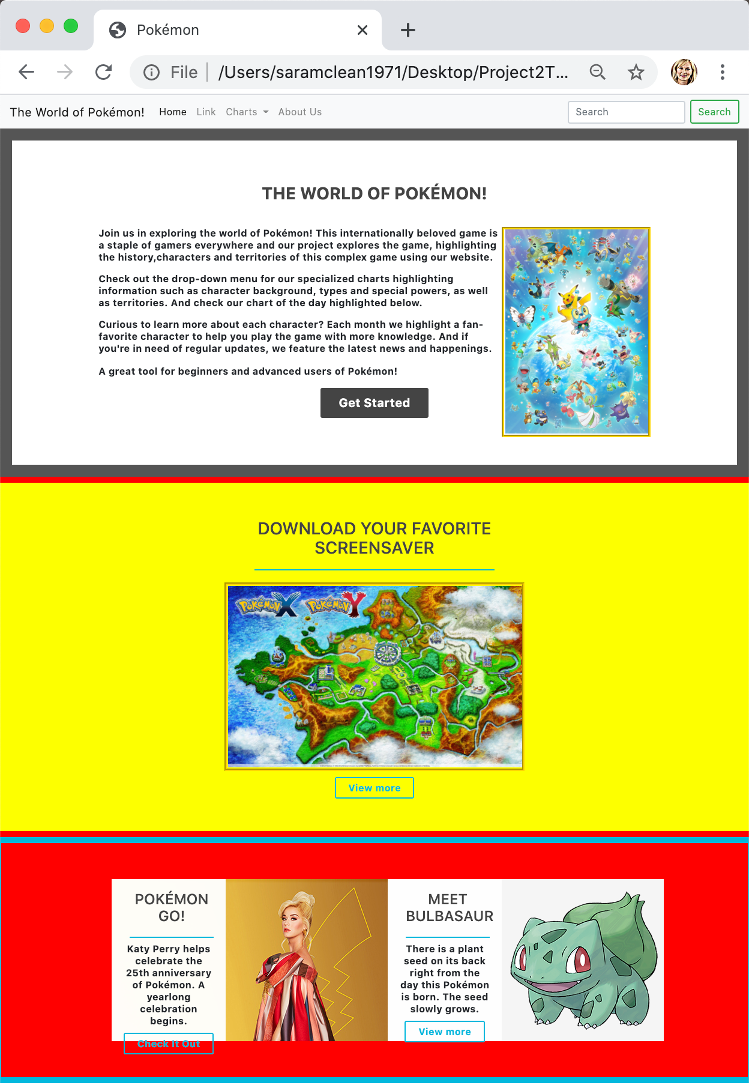
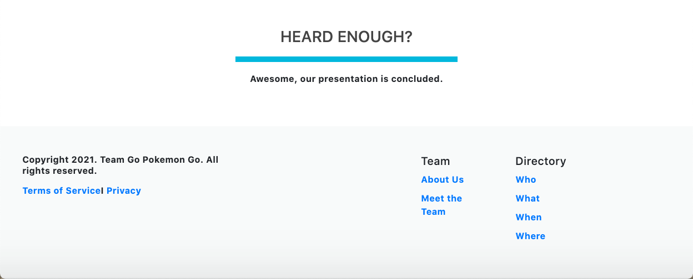
HTML Website Overview
Theme: Pokémon
Long form format
Multiple interactive sections including:
Website Introduction
Download your Favorite Screensaver
Meet a Character
Pokémon GO! Latest news
Footer section with terms, privacy, team information
Notes:
Sara

Slide 12
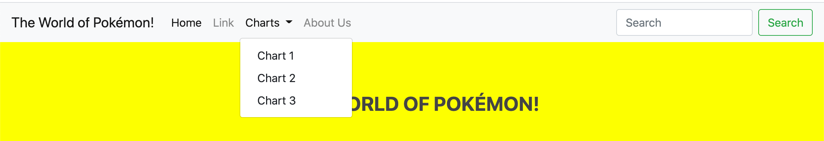
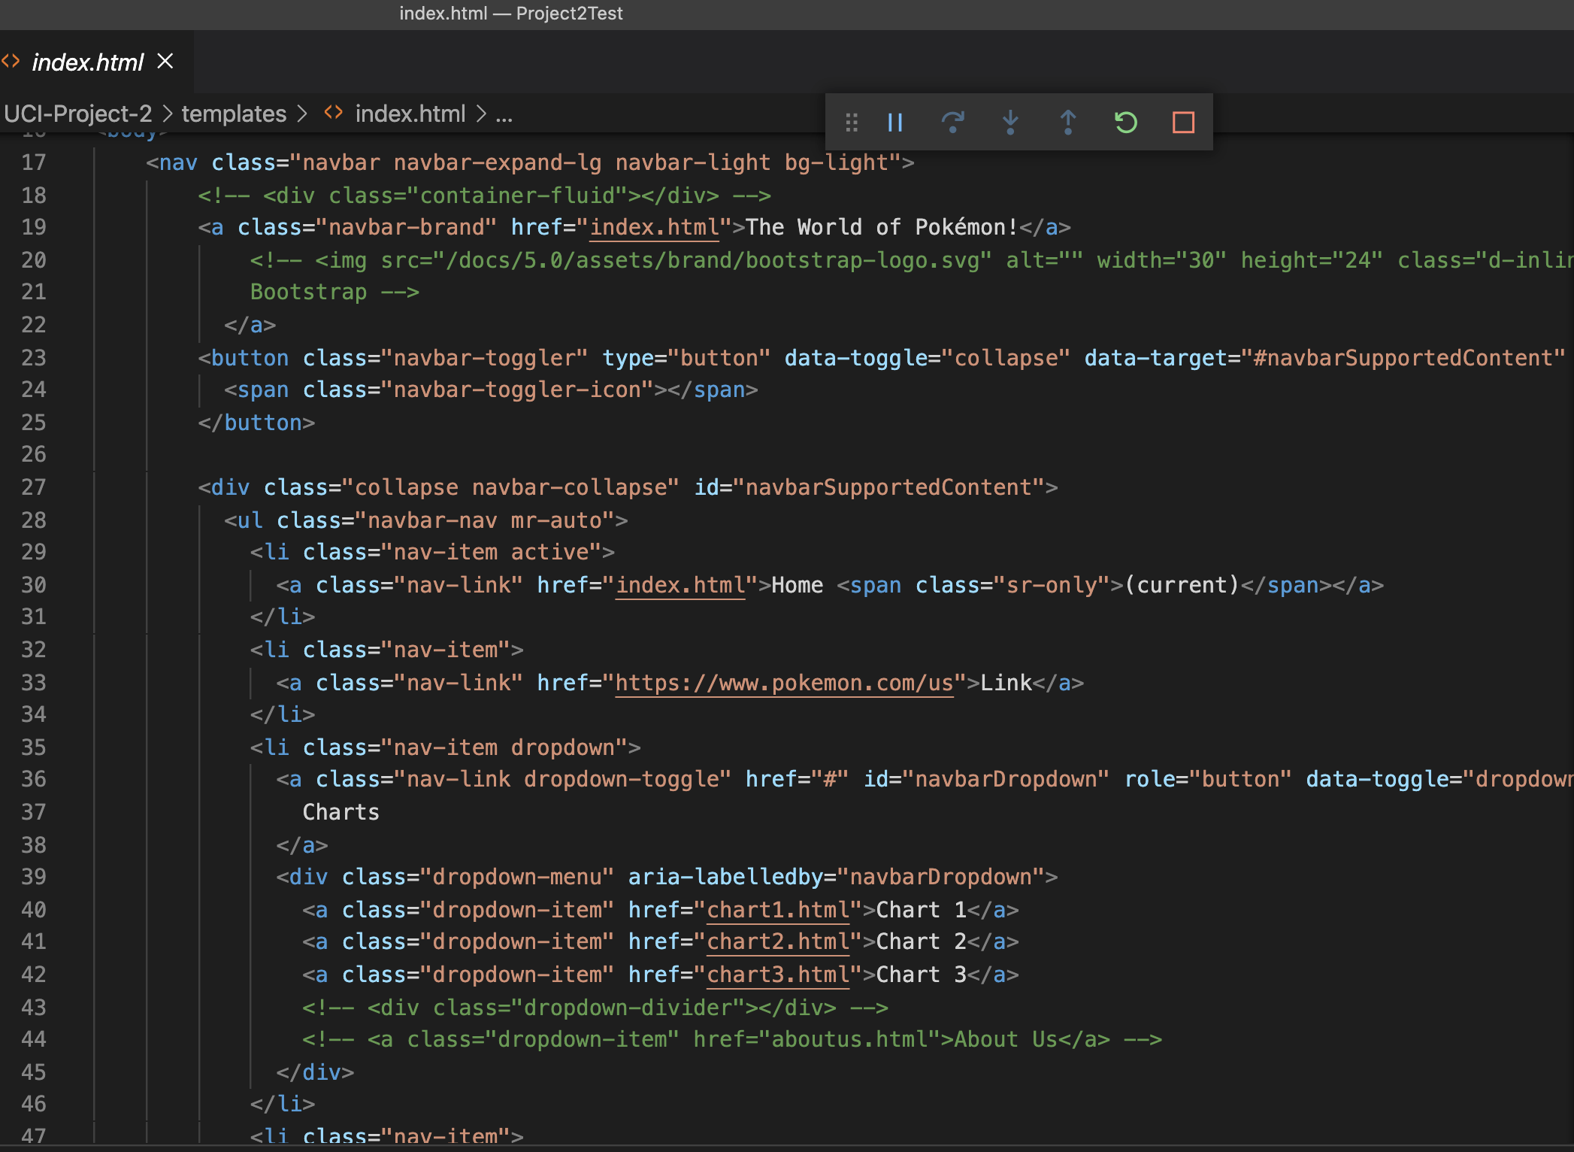
HTML Code – Top Nav
Navigation Bar HTML Code
Utilized Bootstrap nav to set up top navigation
Toggle method between each page
Dropdown menu with 3 chart pages for team
Notes:
Sara

Slide 13
Heatmap
D3-JS powered heatmap
JS code embedded within HTML script tags
HTML part of the code contains a div that is modified by d3
Data consists of 3 columns:
row, col, value
i.e. attacker_type, defender_type, effectiveness
Built scales and axis
A scaleband() used to control the size of each square using the padding property (ranges between 0-1)
Each rectangle added by using a rect element
3 Tooltip functions:
mouseover
mousemove
mouseleave
Handmade Legend:
Each element of the legend has a specific line of code
Allows for more customization but very tedious and time-consuming to implement
Notes:
Vanessa

Slide 14
Bar Chart
D3-JS powered bar chart
Flask driven D3.JS Bar Chart:
Data consists of 2 of 6 available columns:
Pokémon's name and the total power (Sum of the Attack points, Defense points, Hit points (hp), Special Attack points, Special defense points and the Pokémon's Speed.
Pokémon are sorted by the Pokédex number and Generation.
Tooltip:
Color swap on bar selection for Pokémon.
Notes:
Serafin

Slide 15
Radar Chart
Chart.js powered radar plot
JS code embedded within HTML script tags
Data consists of 6 columns:
HP, Attack, Defense, Sp. Attack, Sp. Defense, Speed
Type data averaged across primary class of each Pokémon
Color coded line colors to match each Pokémon Type
Filter Function:
Types can be added or hidden by clicking legend icons
Tooltip:
Tooltip function highlights type and stat being selected
Notes:
Daniel

Slide 16
Summary
Exploring the world of Pokémon has never been so fun!
https://github.com/vlee2020/UCI-Project-2
Infusing the range of programs – Flask API, JSON, web page development, chart developments and database creation – a fully interactive site highlights the globally beloved game for both new and advanced players
DEMO!
Notes:
Daniel (Summary Slide and Transition to Kasim for Demo)

Slide 17
Project Requirements
Python-Flask power API
HTML/CSS
JavaScript
Postgres SQL
Dashboard Page with multiple charts updated from same data
JS Library outside class coverage: Chart.js
Data set with minimum 100 records
User-driven interaction – dropdowns, menus
Final visualization with minimum 3 views

